Slide 1
Exceptions Handling
Exception handling fundamentals
Exception types
Exception as objects
Exception hierarchy
Exception Keywords - Try, catch, finally, throw, throws
Creating User defined Exceptions
Assertion
Annotations
Notes:
Java Programming Handouts

Slide 2


Why use Exception?
In earlier programming language, the things that leads to confusion
  Error detection
  Error reporting
  Error Handling
Take an Example of reading an entire file into memory
Notes:
Java Programming Handouts

Slide 3
Why use Exception? (Continued)
Steps To Be Followed For Reading a File in the memory
  readFile
  {
  open the file;
  determine its size;
  allocate that much memory;
  read the file into memory;
  close the file;
  }
Notes:
Java Programming Handouts

Slide 4
Why use Exception? (Continued)
Can U Guess the potential Errors in this operation
  What happens if the file can't be opened?
  What happens if the length of the file can't be determined?
  What happens if enough memory can't be allocated?
  What happens if the read fails?
  What happens if the file can't be closed?
Notes:
Java Programming Handouts

Slide 5
Why use Exception? (Continued)
To Answer this question your program should have error detection, reporting, and handling mechanism that will look like:
close the file;
if (theFileDidntClose && errorCode == 0)
{
errorCode = -4;
}
else
{
errorCode = errorCode and -4;
}
}
else
{
errorCode = -5;
}
return errorCode;
}
errorCodeType
readFile
{
initialize errorCode = 0;
open the file;
if (theFileIsOpen)
{
determine the length of the file;
if (gotTheFileLength)
{
allocate that much memory;
if (gotEnoughMemory)
{
read the file into memory;
if (readFailed)
{
errorCode = -1;
}
}
else
{
errorCode = -2;
}
}
else
{
errorCode = -3;
}
Notes:
There's so much error detection, reporting, and returning here that the original seven lines of code are lost in the clutter. Worse yet, the logical flow of the code has also been lost, thus making it difficult to tell whether the code is doing the right thing: Is the file really being closed if the function fails to allocate enough memory? It's even more difficult to ensure that the code continues to do the right thing when you modify the method three months after writing it. Many programmers solve this problem by simply ignoring it — errors are reported when their programs crash.
Java Programming Handouts

Slide 6
Why use Exception? (Continued)
Exception helps To Solve this problem
readFile {
try {
open the file;
determine its size;
allocate that much memory;
read the file into memory;
close the file;
}catch (fileOpenFailed)
{
doSomething;
}
catch(sizeDeterminationFailed)
{
doSomething;
}
catch (memoryAllocationFailed)
{
doSomething;
}
catch (readFailed)
{
doSomething;
}
catch (fileCloseFailed)
{
doSomething;
}
}
Notes:
Java Programming Handouts

Slide 7

What is an Exception?
An exception can be defined as an abnormal event that occurs during program execution and disrupts the normal flow of instructions.
Notes:
Java Programming Handouts

Slide 8
Uses of Exception?
Consistent error reporting style.
Easy to pass errors up the stack.
Pinpoint errors better in stack trace.
  As long as you “fail fast” and throw as soon as you find a problem.
Wrap useful information up in your exception classes, use that information later when handling the exception.
Exceptions don’t always have to be errors, maybe your program can cope with the exception and keep going!
Separating error handling code from Regular code
Notes:
Separating error handling code from Regular code - Exceptions provide the means to separate the details of what to do when something out of the ordinary happens from the main logic of a program.
Java Programming Handouts

Slide 9

Types of Errors
1. Compile Time Error
2. Run Time Error
Notes:
Compile Time Error – Occurs during compilation of a program which includes syntax errors, semantic errors etc.
Runtime Error – Generated while running the program. For example, program that connects to another machine to fetch some data but found the target machine off, a error will encounter.
Java Programming Handouts

Slide 10
Exception Occurrence Reason
1. Running out of memory.
2. Resource allocation errors.
3. Inability to find files.
4. Problem in network connectivity.
Notes:
Java Programming Handouts

Slide 11
Exception Occurrence Levels
Hardware/operating system level.
  Arithmetic exceptions; divide by 0, under/overflow.
  Memory access violations; segment fault, stack over/underflow.
Language level.
  Type conversion; illegal values, improper casts.
  Bounds violations; illegal array indices.
  Bad references; null pointers.
Program level.
  User defined exceptions.

Slide 12

Categories of Exceptions
1.
Built in Exceptions
1.a
Checked Exceptions
1.b
Unchecked Exceptions
2.
User Defined Exceptions
Notes:
Java Programming Handouts

Slide 13
Checked Exceptions
Checked exceptions are so called because both the Java compiler and the Java virtual machine check to make sure this rule is obeyed.
The checked exceptions that a method may raise are part of the method's signature.
Every method that throws a checked exception must advertise it in the throws clause in its method definition, and
Every method that calls a method that advertises a checked exception must either handle that exception (with try and catch) or must in turn advertise that exception in its own throws clause.

Slide 14
UnChecked Exceptions
Raised implicitly by system because of illegal execution of program.
Do not need to announce the possibility of exception occurrence.
When unchecked exception occurred, if programmer does not deal with it, it would be processed by default exception handler.
Exception extended from Error class and RuntimeException class.

Slide 15

Java Exceptions Hierarchy
Object
Throwable
Error
Exception
Virtual Machine Error
RuntimeException
…
(Checked Exceptions)
…
(Unchecked Exceptions)

Slide 16
Java Exceptions Hierarchy (Continued)
Exception
RuntimeException
…
(Checked Exceptions)
…
ArrayIndexOutOfBoundException
(Unchecked Exceptions)
Occurs when an attempt is made to access an array element beyond the index of the array.
Notes:
Java Programming Handouts

Slide 17
Java Exceptions Hierarchy (Continued)
Exception
RuntimeException
…
(Checked Exceptions)
…
ArithmeticException
(Unchecked Exceptions)
Occurs when you make an arithmetic error, such as dividing
a number by zero.

Slide 18
Java Exceptions Hierarchy (Continued)
Exception
RuntimeException
…
(Checked Exceptions)
…
NumberFormat
Exception
(Unchecked Exceptions)
Occurs when you want to convert a string in an incorrect
format to a numeric format.

Slide 19
Java Exceptions Hierarchy (Continued)
Exception
RuntimeException
…
(Checked Exceptions)
…
NullPointerException
(Unchecked Exceptions)
Occurs when an application tries to use an object without
allocating memory to it or calls a method of a null object.

Slide 20
Java Exceptions Hierarchy (Continued)
Exception
RuntimeException
…
(Checked Exceptions)
…
ClassCastException
(Unchecked Exceptions)
Occurs when you assign a reference variable of a class to
an incompatible reference variable of another class.

Slide 21
Java Exceptions Hierarchy (Continued)
Exception
RuntimeException
…
(Checked Exceptions)
…
NoSuchMethod
Exception
(Unchecked Exceptions)
Occurs when you call a method that does not exist.
Notes:
There are more Runtime exception class for example, HostNotFoundException, InstantiationException.
Java Programming Handouts

Slide 22
Java Exceptions Hierarchy (Continued)
Exception
RuntimeException
IOException
…
(Checked Exceptions)
…
(Unchecked Exceptions)
When performing IO operation

Slide 23
Java Exceptions Hierarchy (Continued)
Exception
RuntimeException
ClassNotFound
Exception
…
(Checked Exceptions)
…
(Unchecked Exceptions)
Occurs when the Java run time system is unable to find the
class referred.

Slide 24
Java Exceptions Hierarchy (Continued)
Exception
RuntimeException
IllegalAccess
Exception
…
(Checked Exceptions)
…
(Unchecked Exceptions)
Occurs when you want to refer a class that is not
accessible.

Slide 25
Java Exceptions Hierarchy (Continued)
Exception
RuntimeException
InterruptedException
…
(Checked Exceptions)
…
(Unchecked Exceptions)
Thrown when a thread is waiting, sleeping, or otherwise
paused for a long time.

Slide 26

Implementing Exception Handling
1.
try
2.
catch
3.
throws
4.
throw
5.
finally
Notes:
Java Programming Handouts

Slide 27
Implementing Exception Handling
  Using try and catch statements
    The try block encloses the statements that might raise an exception within it and defines the scope of the exception handlers associated with it.
    The catch block is used as an exception-handler. You enclose the code that you want to monitor inside a try block to handle a run time error.
Notes:
Java Programming Handouts

Slide 28
Implementing Exception Handling (Continued)
Implementing Exception Handling using try & catch
try
{
// Statements that cause an exception.
  }
  catch(ExceptionName obj)
  {
  // Error handling code.
  }
Example
Notes:
Java Programming Handouts

Slide 29
Uncaught Exceptions
If an exception is not caught by user program, then execution of the program stops and it is caught by the default handler provided by the Java run-time system
Default handler prints a stack trace from the point at which the exception occurred, and terminates the program
Ex:
class Exc0 {
public static void main(String args[]) {
int d = 0;
int a = 42 / d;
}
} Output:
java.lang.ArithmeticException: / by zero
at Exc0.main(Exc0.java:4) Exception in thread "main"

Slide 30
Implementing Exception Handling (Continued)
public class UnitRate
{
public void calculatePerUnitRate()
{
int qty=20, rate=0,punit=0;
try
{
punit=qty/rate;
  }catch(ArithmeticException ae)
  { System.out.println(“The product rate cannot be Zero, So Per Unit Rate Displayed Below is Invalid ”);
  }
  System.out.println(“The Per Unit Rate is = “+punit);
  }
  }
Arithmetic error occurred and passed to exception handler i.e.
Notes:
Java Programming Handouts

Slide 31
Implementing Exception Handling (Continued)
Using Multiple catch statements / blocks
  A single try block can have many catch blocks.
  The multiple catch blocks generate unreachable code error.
  If the first catch block contains the Exception class object then the subsequent catch blocks are never executed. If this happen it is known as unreachable code problem.
  To avoid unreachable code error, the last catch block in multiple catch blocks must contain the Exception class object.
Notes:
A single try block can have many catch blocks
This is necessary when the try block has statements that raise different types of exceptions.
If the first catch block contains the Exception class object then the subsequent catch blocks are never executed.
The Exception class being the superclass of all the exception classes catches various types of exceptions. The Java compiler gives an error stating that the subsequent catch blocks have not been reached. This is known as the unreachable code problem.
Java Programming Handouts

Slide 32
Implementing Exception Handling (Continued)
Using Multiple catch statements / blocks Example
try {
// dangerous code here!
}
catch(ArithmeticException e) {
// Specific error handling here
}
catch(RuntimeException e) {
// More general error handling here
}
Order Matters!
Less general
first!
Notes:
Note that one catch is more general than the other. Also note that the more specific one here will override the more general one
THE ORDER MATTERS HERE!
Java Programming Handouts

Slide 33
Example
class MultiCatch {
public static void main(String args[]) {
try {
int a = args.length;
System.out.println("a = " + a);
int b = 42 / a;
int c[] = {1};
c[42] = 99;
}
catch (ArithmeticException e) {
System.out.println("Divide by 0: " + e);
}
catch (ArrayIndexOutOfBoundsException e) {
System.out.println("Array index oob: " + e);
}
System.out.println("After try/catch blocks.");
}
}

Slide 34
Example (Cont.)
If no command line argument is provided, then you will see the following output:
  a = 0
  Divide by 0: java.lang.ArithmeticException: / by zero
  After try/catch blocks
If any command line argument is provided, then you will see the following output:
  a = 1
  Array index oob: java.lang.ArrayIndexOutOfBoundsException
  After try/catch blocks.

Slide 35
Nested try Statements
A try statement can be inside the block of another try
Each time a try statement is entered, the context of that exception is pushed on the stack
If an inner try statement does not have a catch, then the next try statement’s catch handlers are inspected for a match
If a method call within a try block has try block within it, then then it is still nested try

Slide 36
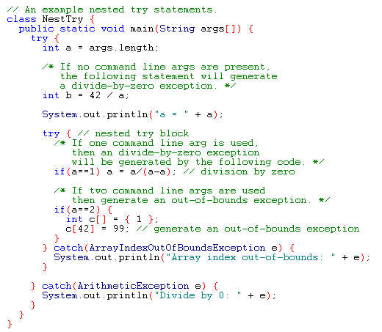
Example

Slide 37
Output
When no parameter is given:
  Divide by 0: java.lang.ArithmeticException: / by zero
When one parameter is given
a = 1
Divide by 0: java.lang.ArithmeticException: / by zero
When two parameters are given
  a = 2
  Array index out-of-bounds: java.lang.ArrayIndexOutOfBoundsException

Slide 38
Implementing Exception Handling (Continued)
Using finally clause
The finally block is used to process certain statements, no matter whether an exception is raised or not.
Syntax of finally block
    try
    {
    // Block of code
    }
    finally
    {
    // Block of code that is always executed irrespective of an exception being raised or not.
    }
Notes:
The try block can be written without catch block by using finally block. In other words the try block should have either a catch block or finally block.
Java Programming Handouts

Slide 39
Implementing Exception Handling (Continued)
try-catch-finally statement
try {
// …
} catch (ExceptionType1 identifier) {
// …
} catch (ExceptionType2 identifier) {
// …
} finally {
// …
}

Slide 40
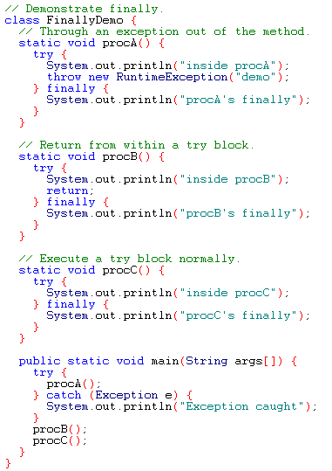
Example

Slide 41
Output
inside procA
procA's finally
Exception caught
inside procB
procB's finally
inside procC
procC's finally

Slide 42
throw
It is possible for your program to throw an exception explicitly
throw ThrowableInstance
Here, ThrowableInstance must be an object of type Throwable or a subclass Throwable
There are two ways to obtain a Throwable objects:
  Using a parameter into a catch clause
  Creating one with the new operator

Slide 43
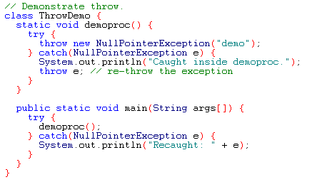
Example
Output:
Caught inside demoproc.
Recaught: java.lang.NullPointerException: demo

Slide 44
Implementing Exception Handling (Continued)
Throwing an Exception
The throw statement causes termination of the normal flow of control of the Java code and stops the execution of the subsequent statements if an exception is thrown when the throw statement is executed.
The throw clause transfers the control to the nearest catch block handling the type of exception object throws.
The following syntax shows how to declare the throw statement:
  throw ThrowableObj
public double divide(int dividend, int divisor) throws ArithmeticException {
if(divisor == 0) {
throw new ArithmeticException(“Divide by 0 error”);
}
return dividend / divisor;
}
Notes:
Java Programming Handouts

Slide 45
throws
If a method is capable of causing an exception that it does not handle, it must specify this behavior so that callers of the method can guard themselves against that exception
  type method-name parameter-list) throws exception-list
  {
  // body of method
  }
It is not applicable for Error or RuntimeException, or any of their subclasses

Slide 46
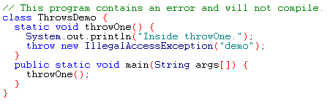
Example: incorrect program

Slide 47
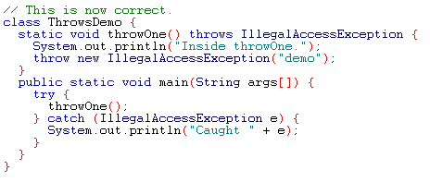
Example: corrected version
Output:
Inside throwOne.
Caught java.lang.IllegalAccessException: demo

Slide 48
Implementing Exception Handling (Continued)
Using Throws Statement
  The throws statement is used by a method to specify the types of exceptions the method throws.
  If a method is capable of raising an exception that it does not handle, the method must specify that the exception has to be handled by the calling method.
  This is done using the throws statement.
[modifiers] returntype methodName(params) throws e1, ... ,en { }
void readData() throws IOException
Notes:
Java Programming Handouts

Slide 49
Exception Propagation
1. public class UnitRate {
2. void calculatePerUnitRate() {
3. int qty = 25, rate = 0,punit=0;
4. punit = qty / rate;
5. }
6. void callPerUnitRate() {
7. calculatePerUnitRate();
8. }
9. public static void main(String[] args) {
10. UnitRate ur = new UnitRate();
11. ur.callPerUnitRate();
12. }
13. }
ArithmeticException Occurred
Output by Default Exception
Handler
java.lang.ArithmeticException: / by zero
at UnitRate.calculatePerUnitRate(UnitRate.java:4)
at UnitRate.callPerUnitRate(UnitRate.java:7)
at UnitRate.main(UnitRate.java:11)

Slide 50
Exception Propagation Exercise
1. public class ExerciseException {
2. public static void main(String[] args) {
3. try {
4. happy1();
5. }
6. catch(Exception e) {
7. e.printStackTrace();
8. }
9. }
10. public static void happy1() throws Exception {
11. happy2();
12. }
13. public static void happy2() throws Exception {
14. happy3();
15. }
16. public static void happy3() throws Exception {
17. throw new Exception(“Be Happy Exception Prevents U!");
18. }
19. }
Write down the Print Stack Trace for the
ExerciseException
class
Notes:
Answer:
java.lang.Exception: Be Happy Exception Prevents U!
at ExerciseException.happy3(ExerciseException.java:17)
at ExerciseException.happy2(ExerciseException.java:14)
at ExerciseException.happy1(ExerciseException.java:11)
at ExerciseException.main(ExerciseException.java:4)
Java Programming Handouts

Slide 51
User Defined Exception
Creating Your Own Exceptions
Defining your own exceptions let you handle specific exceptions that are tailor-made for your application.
Steps to Create a User Defined Exception
  Create a class that extend from a right kind of class from the Exception Hierarchy.
  Let’s make a DivideByZeroException for use by our UnitRate class.
Notes:
Java Programming Handouts

Slide 52
User Defined Exception (Continued)
public class DivideByZeroException extends ArithmeticException
{
public DivideByZeroException()
{
super("Divide by 0 error");
}
}
Here we extended
ArithmeticException.
Notes:
Remember, we choose parents wisely because of specifity; we like the idea of catching DivideByZeroException objects
whenever we decide we want to catch ArithmeticException errors.
Java Programming Handouts

Slide 53
  Errors can be broadly categorized into two groups on the basis of whether the compiler is able to handle the error or not, such as compile time errors and run time errors.
  An exception is a run time error that can be defined as an abnormal event that occurs during the execution of a program and disrupts the normal flow of instructions.
  In Java, the Throwable class is the superclass of all the exception classes. It is the class at the top position in the exception class hierarchy. The Exception class and the Error class are two direct subclasses of the Throwable class.
  The built-in exceptions in Java are divided into two types on the basis of the conditions where the exception is raised:
    Checked Exceptions or Compiler-enforced Exceptions
    Unchecked exceptions or Runtime Exceptions
Summary
Notes:
Java Programming Handouts

Slide 54
Summary (Continued)
  You can handle exception using
    try
    catch
    throws
    throw
    finally
  You use multiple catch blocks to throw more than one type of exception.
  The finally clause is used to execute the statements that need to be executed whether or not an exception has been thrown.
  The throw statement causes termination of the normal flow of control of the Java code and stops the execution of subsequent statements after the throw statement.
  The throws clause is used by a method to specify the types of exceptions the method throws.
  You can create your own exception classes to handle the situations specific to an application
Notes:
Java Programming Handouts

Slide 55
Test Your Understanding
The two subclasses of the Throwable class are:
  Exception class and Error class
  Exception class and Object class
  Error class and RunTimeException class
  Exception class and RunTimeException class
The Throwable class is the sub class of _______ class.
  Exception
  Error
  Object
  RunTimeException
Notes:
Answers:
1. a. Exception class and Error class
2. c. Object
3. c. InstantiationException
4. c. Both, statements A and B, are true
Java Programming Handouts

Slide 56
Test Your Understanding (Continued)
  Which exception occurs when you try to create an object of an abstract class or interface?
    ClassNotFoundException
    IllegalAccessException
    InstantiationException
    NoSuchMethodException
Notes:
Java Programming Handouts

Slide 57
Test Your Understanding (Continued)
  Consider the statements:
  Statement A: The scope of the catch block is restricted to the statements in the preceding try block only.
  Statement B: A try block must have at least one catch block that follows it immediately.
  Which of the following options is true?
    Statement A is true and statement B is false
    Statement A is false and statement B is true
    Both, statements A and B, are true
    Both, statements A and B, are false
Notes:
Java Programming Handouts

